Slide 1




Quantitative Pricing Studies
Methodological Overview

Slide 2
Agenda
General Overview
Payer Research
Physician Research
Integration

Slide 3
Our quantitative modeling approach centers around carefully structured payer and physician research
General Overview
Payer Research
Aimed at understanding how formulary coverage decisions are impacted by pricing, clinical attributes, and other environmental factors (e.g., regulatory changes)
Includes an exercise with a set of scenarios in which payers are asked to make formulary decisions similar to those they would make as part of a P&T committee
Physician Research
Aimed at understanding how physician prescribing behavior is impacted by coverage levels, clinical attributes, patient attributes, and other factors
Includes an exercise with a set of scenarios in which physicians are asked to make treatment decisions similar to those they would make on a daily basis
INTEGRATION
Our individual research components are carefully designed to ensure that they will link up well during the integration phase
In some markets, we add on research with patients and/or pharmacists in order to gain a sharper understanding of how coverage and co-pay levels impact final product shares

Slide 4
Our payer research captures the relationship between product attributes (e.g., price and clinical attributes) and access/reimbursement
General Overview
Potential scenario components
Outputs
MCO A
Product X profiles (X1, X2)
Competitor price options (CP1, CP2)
Product X price options (A1, B1, C1, D1)
Market Dynamics (O1, 02)
MCO price sensitivity
Price dependent reimbursement and access scenarios for the hospital P&T modeled phase and the clinic modeled phase
MCO B
MCO X
100%
Product X reimbursement and access
Etc…
Scenario #3
Unrestricted
Scenario #2
75%
Scenario #1 | Prod A | Prod B | Prod C | Prod D
Profile | AAA | BBB | CCC | DDD
Average weighted price | $15 | $20 | $75 | $15
Reimbursement Methodologies
Access Control
50%
% of covered lives
Prior authorization
25%
No coverage
0%
Price Level 1
Price Level 2
Price Level 3
Price level 4
Illustrative

Slide 5
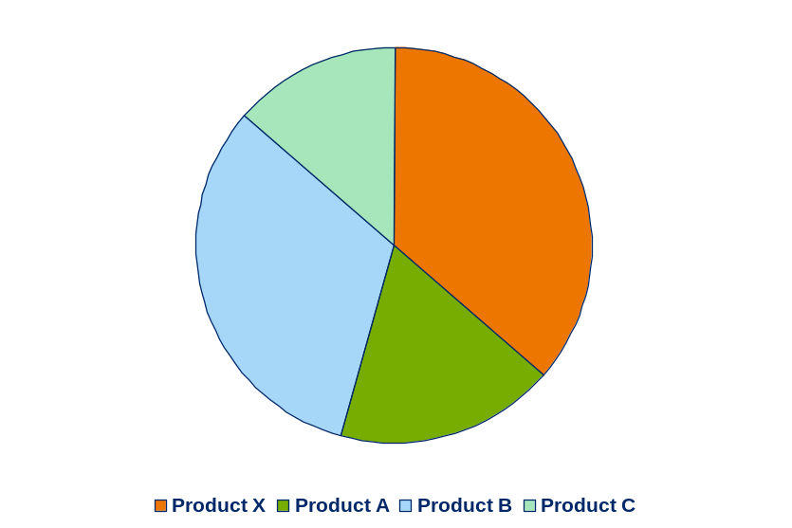
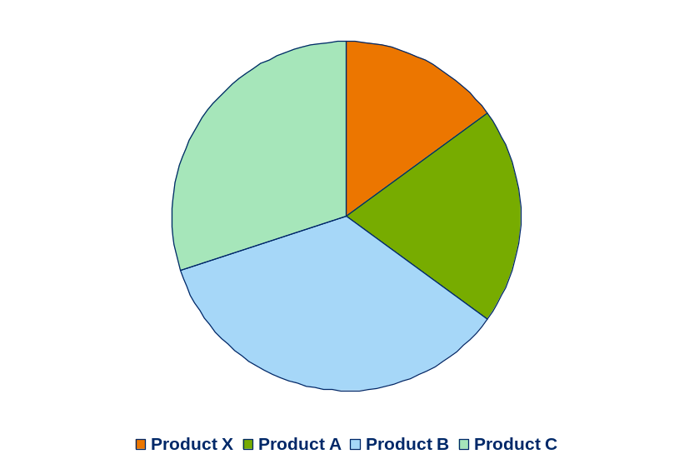
Our physician research allows us to understand the feed-through effect of access/reimbursement on physician prescribing
General Overview
We can see product X share by patient type as guidelines vary…
… And how share of other products shift under various conditions
Product X Preference Share
Preference Share
Product X Tier 2
Preference Share
Product X Tier 3
Share of
preference
100
PATIENT A
PATIENT B
50
PATIENT C
0
PATIENT D
Unrestricted
Step
Prior
No
Auth
coverage
Illustrative

Slide 6
The combination of the payer and physician findings reveals the optimal price range and informs our strategic recommendations
General Overview
Payer/Hospital Price Sensitivity
Share of
Physician Prescribing
100%
preference
75%
Unrestricted
Prior Auth
100
PATIENT A
% of lives
50%
PATIENT B
50
PATIENT C
25%
Non-formulary
0
PATIENT D
0%
Price level 4
Price Level 1
Price Level 2
Price level 3
Unrestricted
Step
Prior
No
Auth
coverage
H
The model displays the price/revenue tradeoffs the products for various subsets of the market
Both
Relative Revenue
Patient Type C
L
Patient Type A
Price
L
Price
H
Illustrative

Slide 7
Agenda
General Overview
Payer Research
Physician Research

Slide 8
Our payer research typically consists of one-on-one discussions with payers which include both qualitative and quantitative elements
Payer Research – Discussions/Quant Scenarios
MCO Medical Director Research
One on one, in-depth expert led interviews with two sections
Qualitative Section Format
Modeled Section Format
Open ended questions and pointed probing questions to get at decision nuances
Scenario-based discrete choice questions
The qualitative section allows us to understand the rationale behind medical director reimbursement and access decisions, the tradeoffs considered and how we position our product
The modeled section allows us to explicitly test the scenarios into which we think the product may phased and to model the reimbursement and access results
Typical sample sizes usually range between 20-30 payers

Slide 9
A discrete choice exercise presents scenarios with varying attributes
Payer Research – Discussions/Quant Scenarios
Product W Price
$1.13
Product Y Prices
$2.50
$3.23
$3.97
$4.70
Product Z Prices
$2.80
$3.95
$4.70
$5.40
$6.10
Product X Prices
$6.80
$8.10
Product Z Label
Disease severity (low)
Disease severity (high)
Product X Label
Disease severity (low)
Disease severity (high)
Depending on the number of attributes and levels tested, we either present all combinations of the attributes (full factorial design) or a subset (based on a fractional factorial design)

Slide 10
The design of Payer Studies requires a careful consideration of a number of different aspects
Payer Research – Discussions/Quant Scenarios
Explicitly designed attribute variation
The number of levels and attributes is arrived at based on discussions with the client
Several limitations
  We don’t want to walk payers through too many scenarios (usually keep to 16 or less)
  Due to small sample sizes, we typically do not want to have to block the design
  There needs to be enough scenarios to estimate the coefficients
  Ideally, the design should be balanced
  →Each level should occur an equal number of times
  →The cross of any two attributes should ideally occur an equal number of times
  %mktruns and %mktdes macros used to generate designs
  →Example programs available in various folders
Qualitatively probed variation
Clients are frequently interested in understanding both prices and discounting/contracting in the same exercise
To avoid incorporating both into the design, we usually probe around contracting qualitatively and capture the additional information for modeling purposes (effectively increasing the number of “scenarios”)

Slide 11
The information collected during the interviews depends on the type of product
Payer Research – Data Collection/Coding
Prescription Products (decision makers within MCOs and PBMs)
For our client’s products and key competitors, we collect the following type of information (for both the commercial and the Medicare part D benefit)
Tier – Relative co-pay position of product compared to competitors (note taken if not covered)
Prior Authorization requirements (e.g., specialist or patient type restrictions)
Step Therapy requirements
Prior authorization mechanisms for expensive products (e.g., phone call/fax vs. peer-to-peer review)
Hospital Based Products (decision makers are hospital administrators)
For our client’s product and key competitors, we collect the following type of information
Formulary Status (on-formulary, off-formulary)
Access restrictions (e.g., requires specialists approval)

Slide 12
The scenario section is presented on a secure Cambridge website and the information coded up for modeling purposes
Payer Research – Data Collection/Coding
INSERT Screen Shot Here – Instructions for Web-site maintained within Cambridge

Slide 13
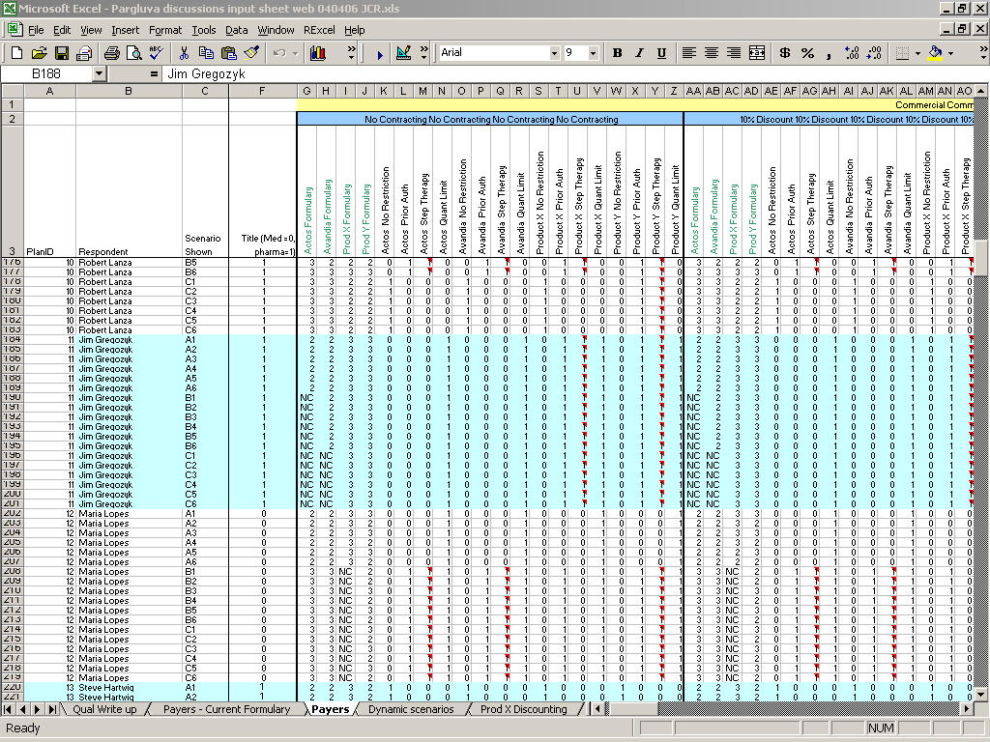
Illustrative Data Set (Additional Documentation being developed)
Payer Research – Data Collection/Coding

Slide 14
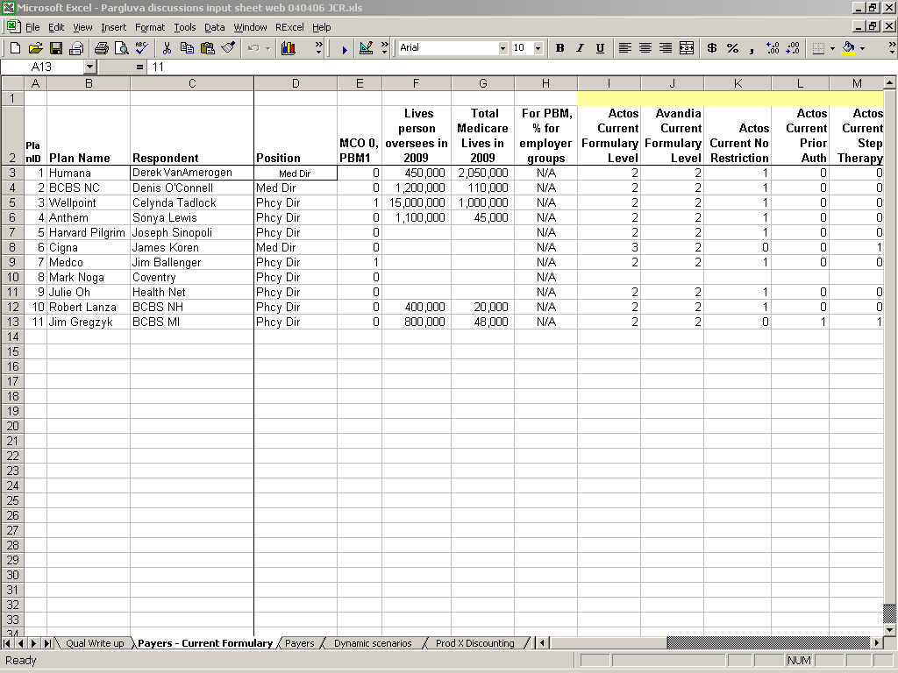
Plan level information is also collected as part of the interviews (used for segmentation and weighting purposes)
Payer Research – Data Collection/Coding

Slide 15
If the data contains multiple discounting scenarios in each row, the data is transposed (done in SAS or Excel) so that each row contains a single discounting scenario…
Payer Research – Data Collection/Coding
INSERT Screen Shot Here

Slide 16
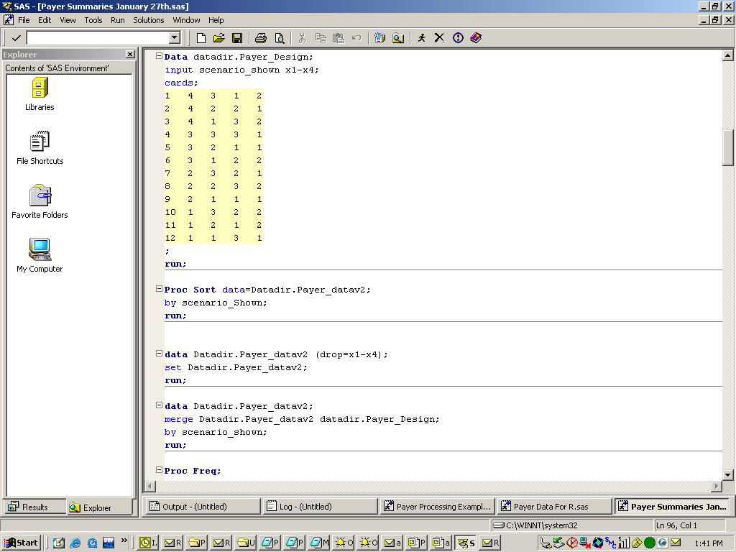
The data is read into SAS and merged in with the experimental design

Slide 17
…Next, the information from all the various reimbursement and restriction variables are examined and dummy coded into a combined variable with the combinations that occurred in the data
Payer Research – Data Collection/Coding
Illustrative
Tier Variable
Tier 2
Tier 3
Not Covered
Combined Variable
Tier 2 – No PA
Tier 2 – PA
Tier 3 – No PA
Tier 3 – PA
Not Covered
Prior Authorization Variable
No Prior Authorization
Prior Authorization

Slide 18
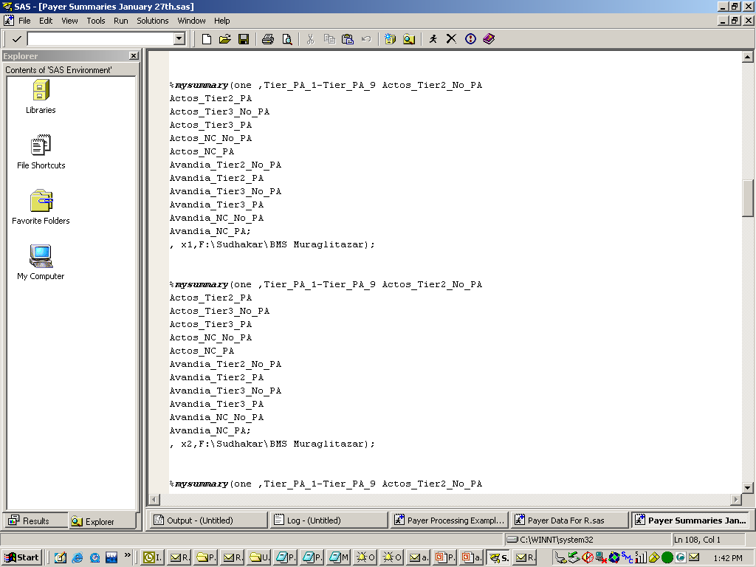
Summary Macros are run in order to understand the univariate dependence on the various attributes
Note: These summaries are written to an Excel file

Slide 19
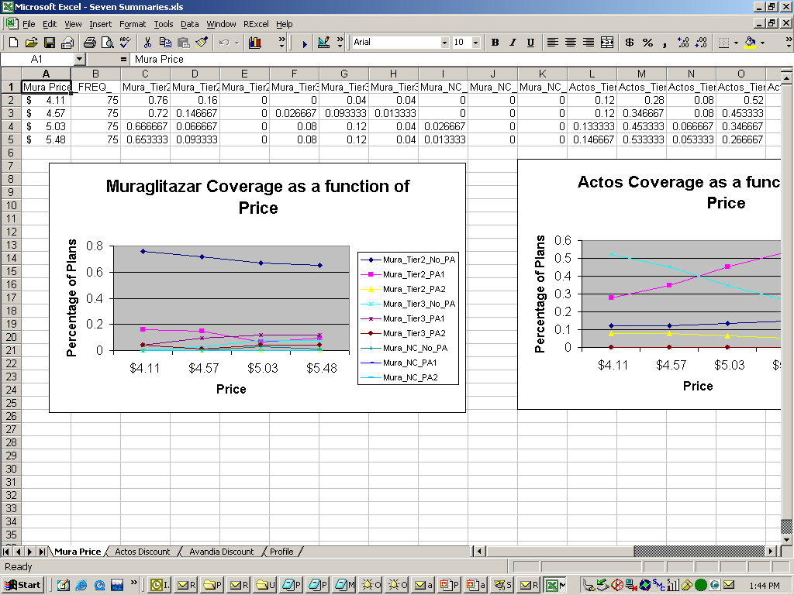
The summaries are plotted to get a first read on the data
Note: The Summaries are shared with Cambridge and used as a QC on the final model

Slide 20
Once the dummies are created, the analysis proceeds differently depending on the complexity of the study
Payer Research – Modeling
Full Factorial Design
The collected data contains all the possible combinations of the tested variables
→Raw data used to create the databases required for the simulator
Fractional Factorial Design
The collected data contains a carefully selected subset of all the possible combinations of the tested variables
→Data brought into R and a Hierarchical Bayesian Model (with individual intercepts, but not responsiveness coefficients) is run using WINBUGS that enables plan level predictions for each combination of the attributes
→Simulation run output brought back into SAS and used to generate a database containing predictions for all combinations of the variables at the plan level
→Plan level database used to create the databases required for the simulator

Slide 21
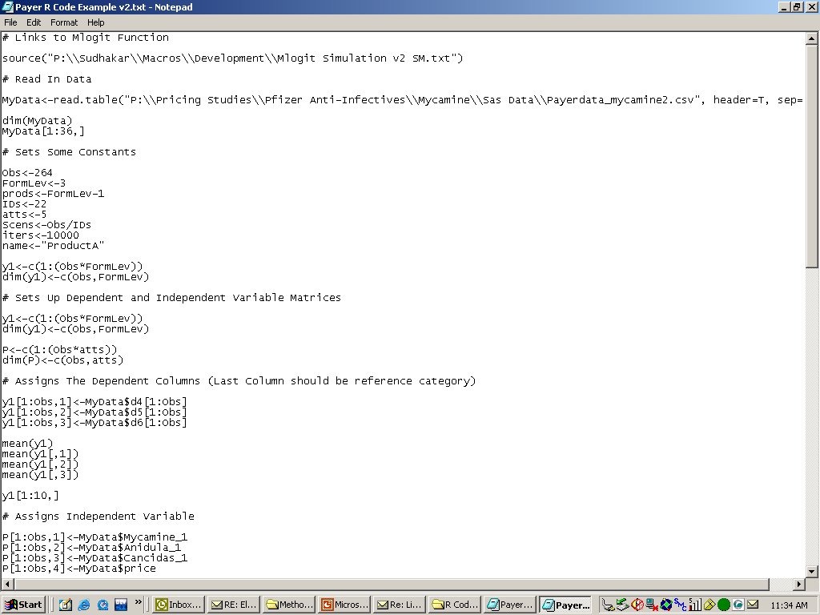
Illustrative R Code – Part 1 – Additional details being developed in word document
Payer Research – Modeling
Note: A separate model is developed for each product

Slide 22
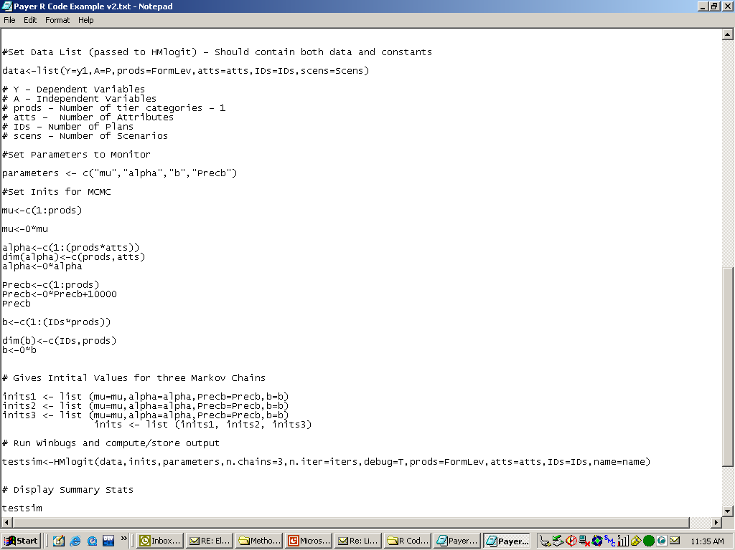
Illustrative R Code – Part 2 – Additional details being developed in word document
Payer Research – Modeling

Slide 23
The R code writes output to several .csv files in the local Bayes subdirectory – These should be copied to an appropriate directory for processing
Payer Research – Modeling
Modelname_Means.csv
  Contains the means of the model coefficients
Modelname_Aggs.csv
  Contains draws for the aggregate (shared coefficients)
Modelname_Inds.csv
  Contains draws for individual coefficients
Note: Due to the Bayesian aspect of these models, each draw represents a separate prediction. The separate predictions are averaged during the processing

Slide 24
The data is read into SAS and used in order to produce plan level predictions for each scenario (similar to that generated by a full factorial design)
Payer Research – Processing – Fractional Factorial Designs
Examples: Payer processing examples 1,1b, and 1c
Contains detailed walk through of how to run processing

Slide 25
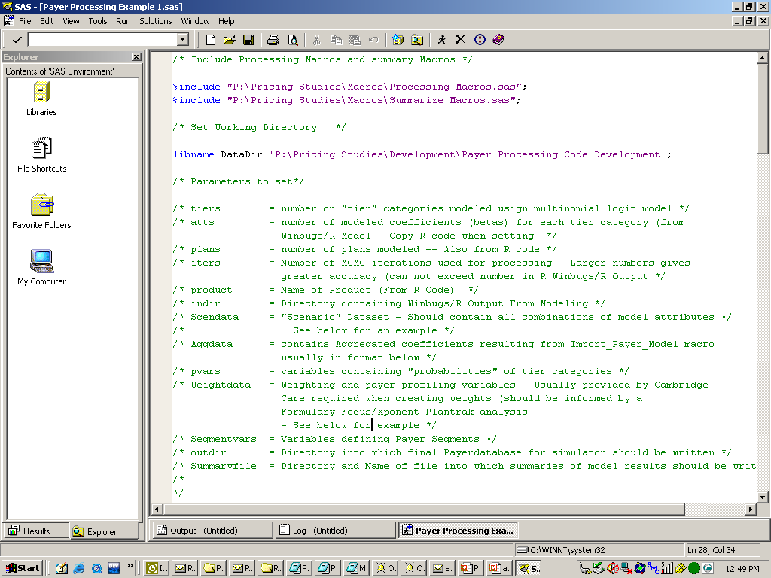
Two include statements are used to include key Macros, and a set of Macro variables are set (described below)
Payer Research – Processing – Fractional Factorial Designs

Slide 26
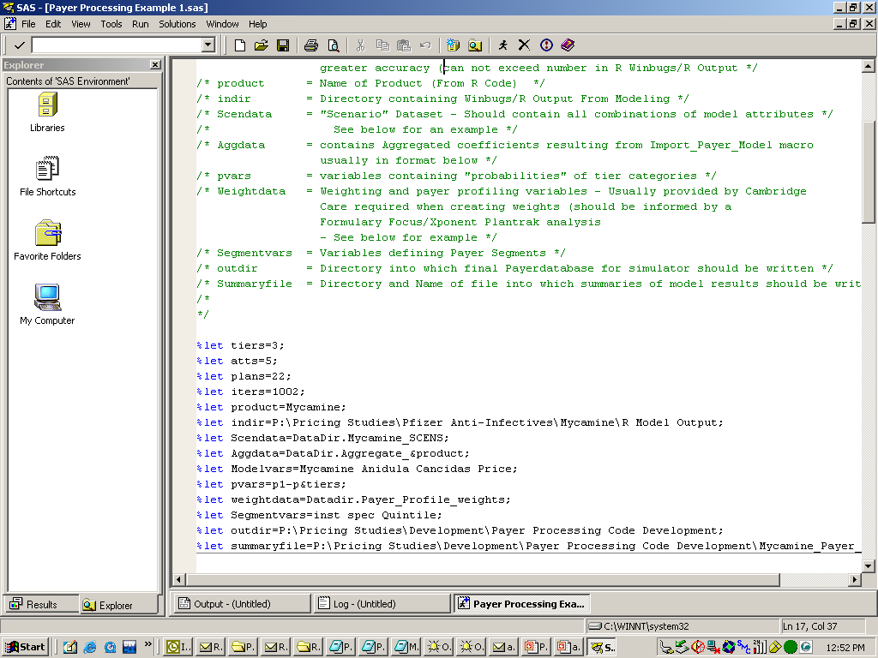
Illustration – Setting the Macro variables
Payer Research – Processing – Fractional Factorial Designs

Slide 27
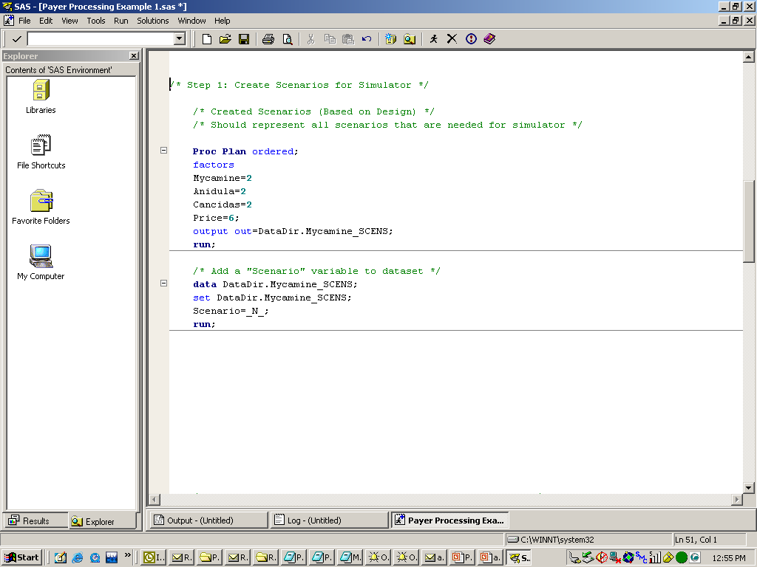
Step 1A: A data set containing the attribute combinations needed for the simulator are generated using a Proc Plan statement
Payer Research – Processing – Fractional Factorial Designs
A scenario variable is also added to the dataset

Slide 28
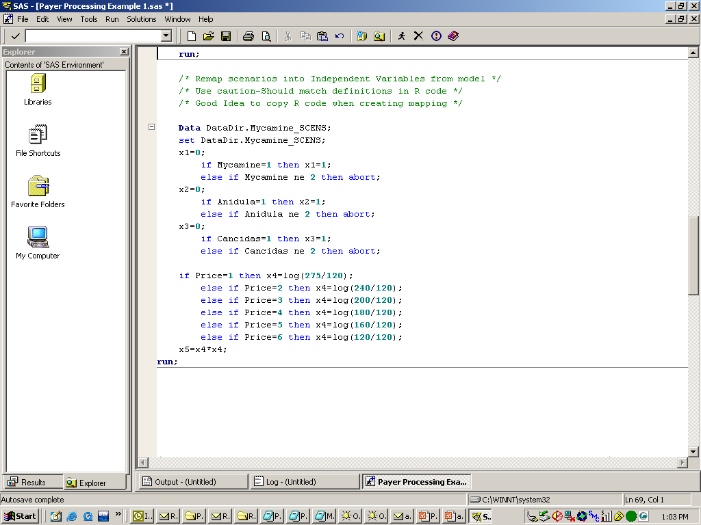
Step 1B: The design variables are remapped into those used in the statistical model (x1-xK)
Payer Research – Processing – Fractional Factorial Designs

Slide 29
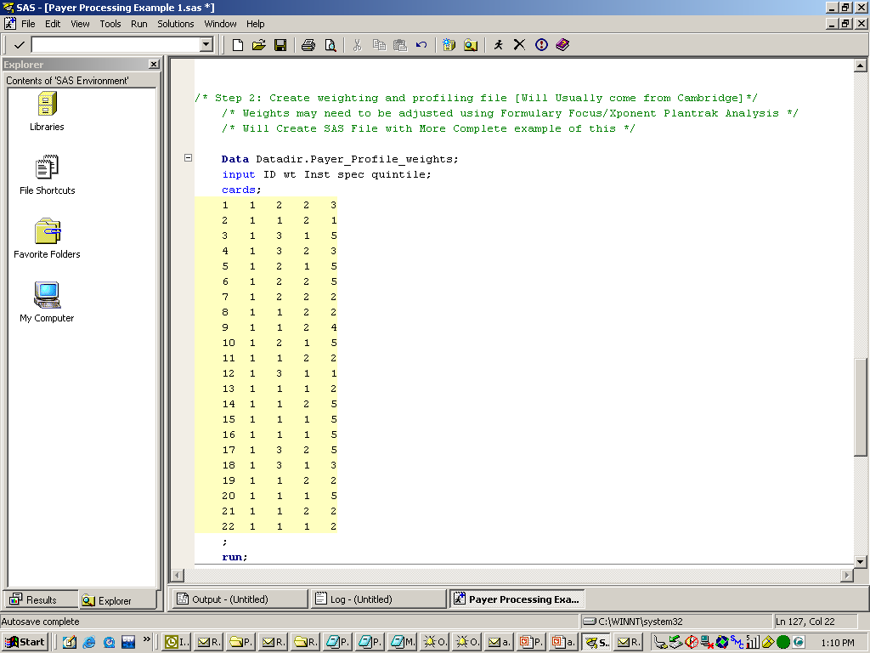
Step 2: A dataset containing weighting and segment information is created (usually based on Cambridge provided information)
Payer Research – Processing – Fractional Factorial Designs
Note: Dataset must have same name as Macro variable defined earlier

Slide 30
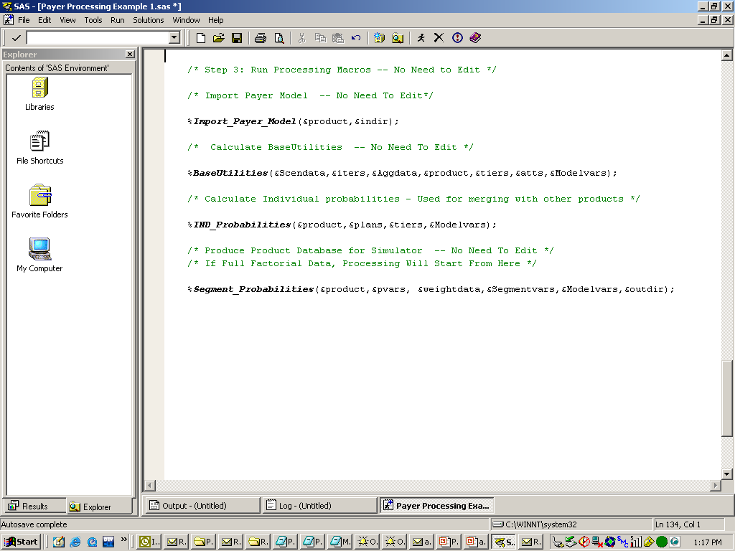
Step 3: Four Macros are called in order to generate the required database for the simulator – The arguments are the Macro variables defined above
Payer Research – Processing – Fractional Factorial Designs

Slide 31
Description of Macros
Payer Research – Processing – Fractional Factorial Designs
Import_Payer_Model()
  Imports csv files into SAS and recodes for other Macros
Baseutilities()
  Uses information from aggregate coefficients and Scenario dataset in order to generate “utilities” for each scenario
Ind_Probabilities()
  Generates plan level predictions for each scenario (average across all the draws) using baseutilities and individual intercepts
Segment_Probabilities()
  Generates database with predictions aggregated to highest level possible based on segmentation variables
Note: Processing repeated for each product modeled

Slide 32
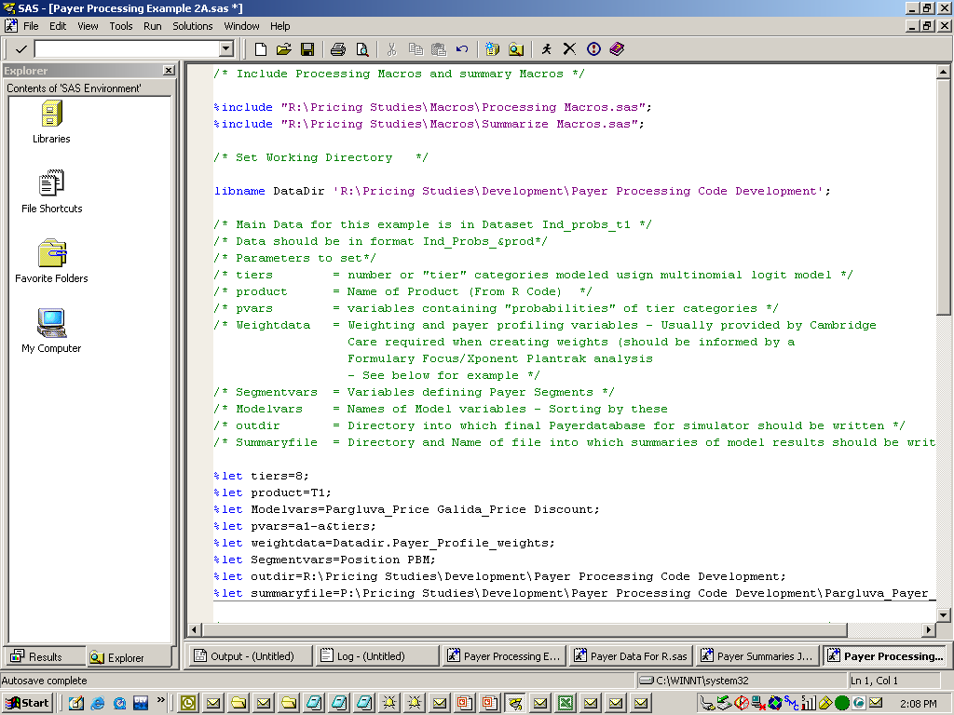
If the data is based on a full factorial design, no modeling is done and the analysis proceeds to processing based on the data itself
Payer Research – Processing – Full Factorial Designs
Examples: Payer processing example 2
A reduced number of Macro variables are needed in this case

Slide 33
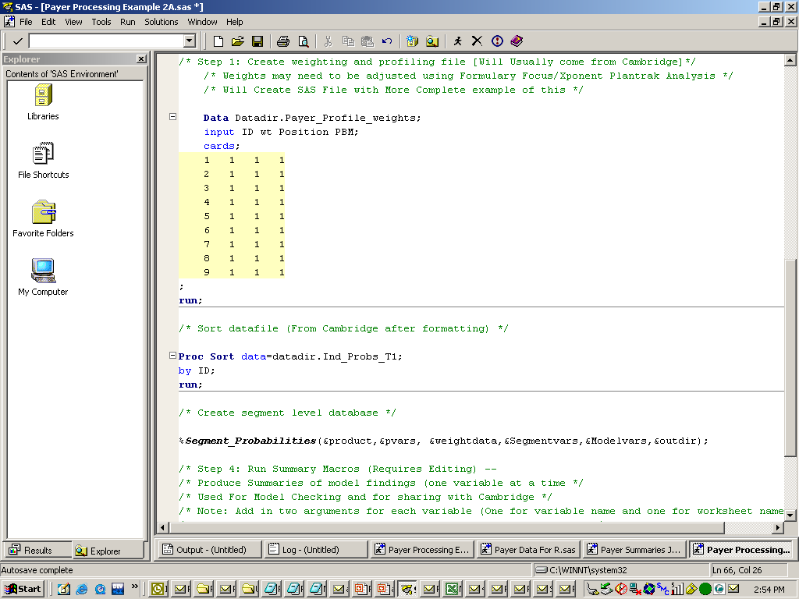
The weighting/segmentation dataset is still created, but only the last of the four Macros is used
Payer Research – Processing – Full Factorial Designs

Slide 34
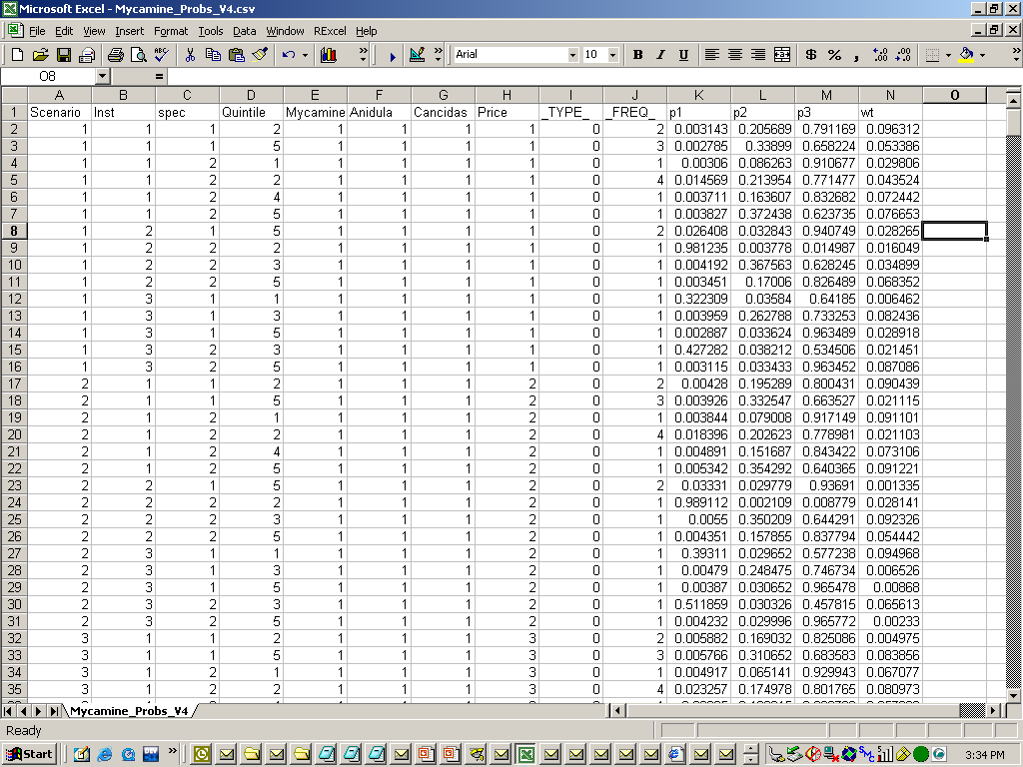
In both cases, the final databases are used as inputs into the simulators
Payer Research – Simulator Construction
Segment Variables
Model Variables
Model Predictions
Weighting Variable

Slide 35
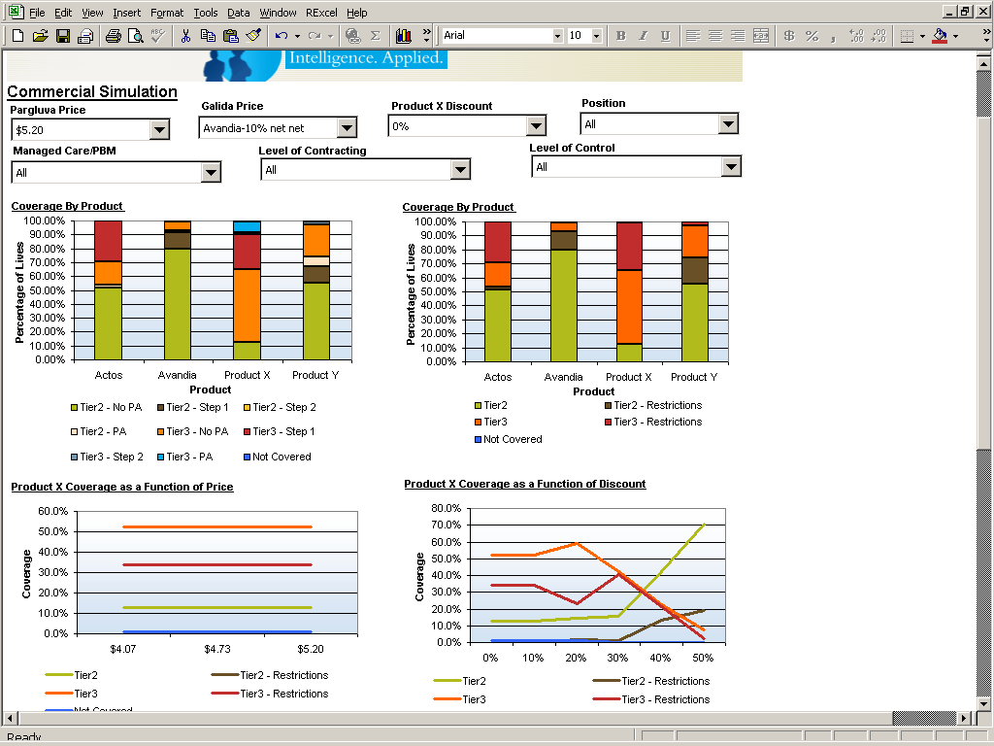
The simulator provides a user-friendly interface for the information provided by the database
Payer Research – Simulator Construction
Bar charts display the coverage for individual products at the selected settings
Graphs display the dependence of product performance on price and discounting

Slide 36
Agenda
General Overview
Payer Research
Physician Research
Integration

Slide 37
The physician quant study tests prescriber preference for products as a function of Access/Reimbursement and other products as well as patient attributes
Physician Research/Quant Scenarios
How will prescribers…
Decide among treatment options…
When presented with these types of patients…
PCPs
Specialists
For example…
Dalbavancin
Zyvox
Vancomycin
Teicoplanin
Patient type A
Patient type B
Patient type C
Patient type D
Primary product dimension for testing
Primary patient dimension
Tiers and PAs
(From Payer Research)
Patient condition
How do these dimensions impact product preference?
Secondary product dimension for testing
Secondary patient dimensions
Insurance status
Co-morbidities
Age
Efficacy
Safety
Delivery Mechanism

Slide 38
A discrete choice exercise presents scenarios with varying attributes
Physician Research/Quant Scenarios
Product W Tier
Tier 2 – No PA
Tier 3 – No PA
Tier 2 – PA
Not Covered
Product Y Tier
Tier 2 – No PA
Tier 3 – No PA
Tier 2 – PA
Tier 3 – PA
Product Z Tier
Tier 2 – No PA
Tier 3 – No PA
Tier 2 – PA
Tier 3 – PA
Product X Tier
Tier 2 – No PA
Tier 3 – No PA
Tier 2 – PA
Tier 3 – PA
Product Attributes
Product Z Label 1
Product Z Label 2
Product X Label 1
Product X Label 2
Disease marker
Low
Medium
High
Out of Pocket Costs
High
Low
Patient Attributes
Depending on the the type of study, physicians are either asked to make discrete choices (preferred)or to allocate share across products

Slide 39
The design of Physician Studies also requires a careful consideration of a number of different aspects
Physician Research – Quant Scenarios
Explicitly designed attribute variation
The number of levels and attributes is arrived at based on discussions with the client
In most pricing studies, these will typically include Tier/PA/Step therapy information for the key products (corresponding to what the main levels utilized by Payers in the Payer Studies
In some cases (e.g., infusion products), it may make sense to present Physicians with prices as well (not true for most products)
Several limitations
  We don’t want to walk payers through too many scenarios (usually keep to 16 or less)
  We want to limit the number of patient types displayed on each screen
  Frequently, the design needs to be blocked
  There needs to be enough scenarios to estimate the coefficients
  Ideally, the design should be balanced
  →Each level should occur an equal number of times
  →The cross of any two attributes should ideally occur an equal number of times
  %mktruns and %mktdes macros used to generate designs
  →Example programs available in various folders

Slide 40
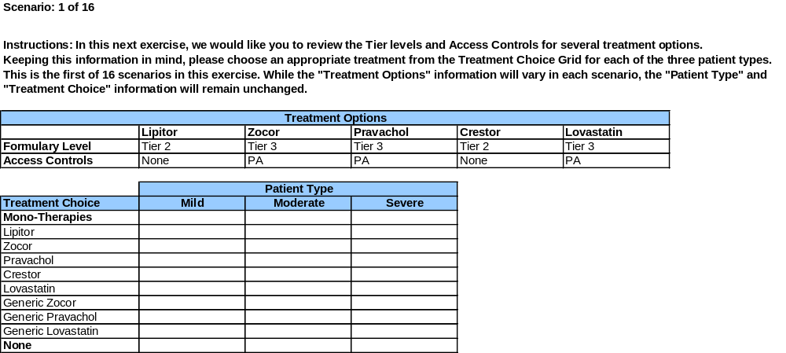
The survey is usually fielded by an outside vendor and the scenarios information presented on the screen
Physician Research – Quant Scenarios
Illustrative

Slide 41
When the data is received, it is converted into a format where the observations are at the scenario/respondent level and merged in with the experimental design
Each record should contain the following:
  Physician ID
  Design Scenario
  Responses (e.g., selected products)
  Design Variables
The response variables and design variables are recoded (usually using dummies) for modeling purposes as follows
  Each treatment option should have a dummy variable
  Each level of the design variable will typically need to be dummy coded

Slide 42
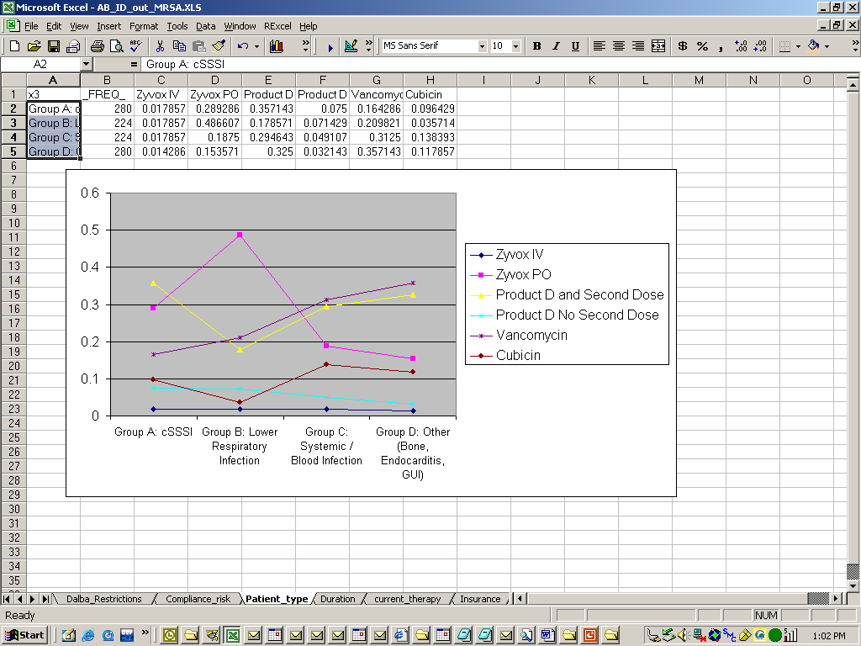
The data is summarized for each model variable using summary MACROS and plotted in Excel
Physician Research – Summaries
Note: The Summaries are shared with Cambridge and used as a QC on the final model

Slide 43
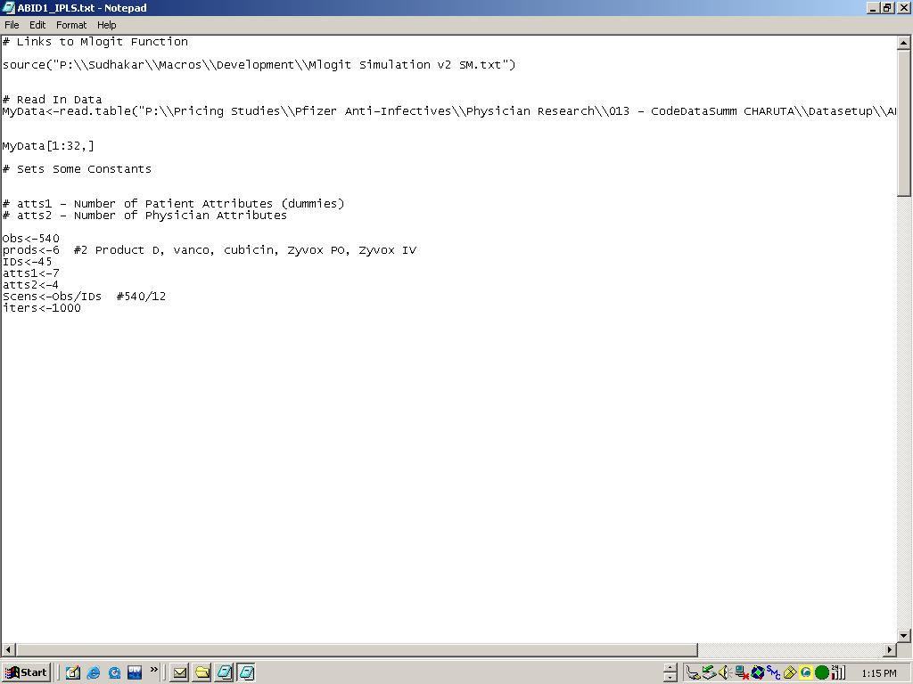
The data is exported to a .csv file and then read into R for analysis
Physician Research – Modeling
First the data is read in and several constants set

Slide 44
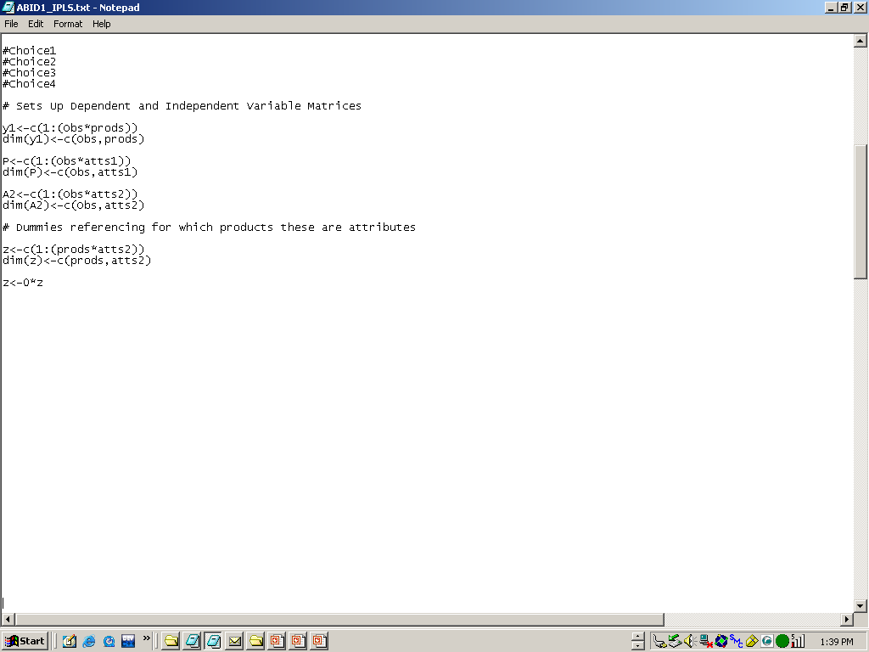
Next, some of the matrices used in the estimation are initialized…
Physician Research – Modeling

Slide 45
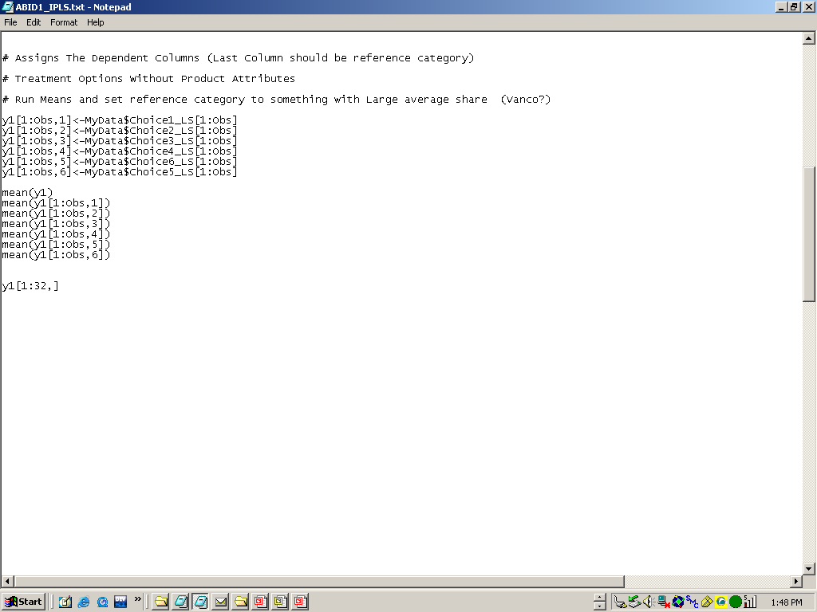
The dependent Variables are assigned…
Physician Research – Modeling

Slide 46
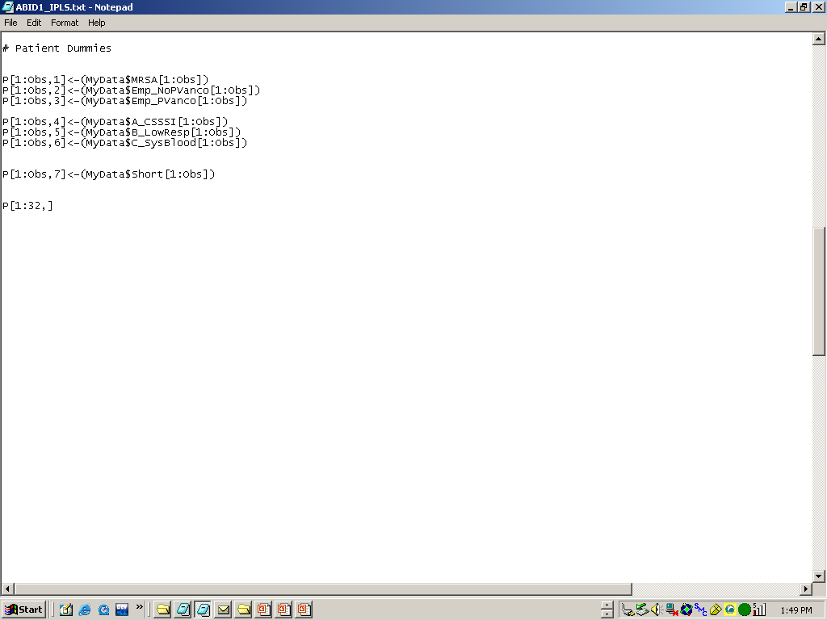
Physician Research – Modeling
…next, the patient variables are assigned to the P matrix

Slide 47
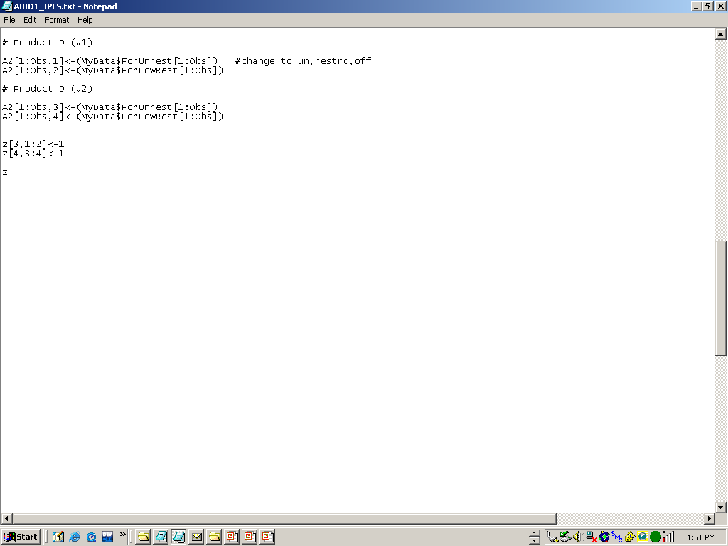
…and the product attribute variables are coded into the A2 matrix
Physician Research – Modeling
Note: the z matrix is used to align products with the product attributes
Z[3,1:2] means that product attributes 1 and 2 enters the utility for product 3
Z[4,3:4] means that product attributes 3 and 4 enters the utility for product 4

Slide 48
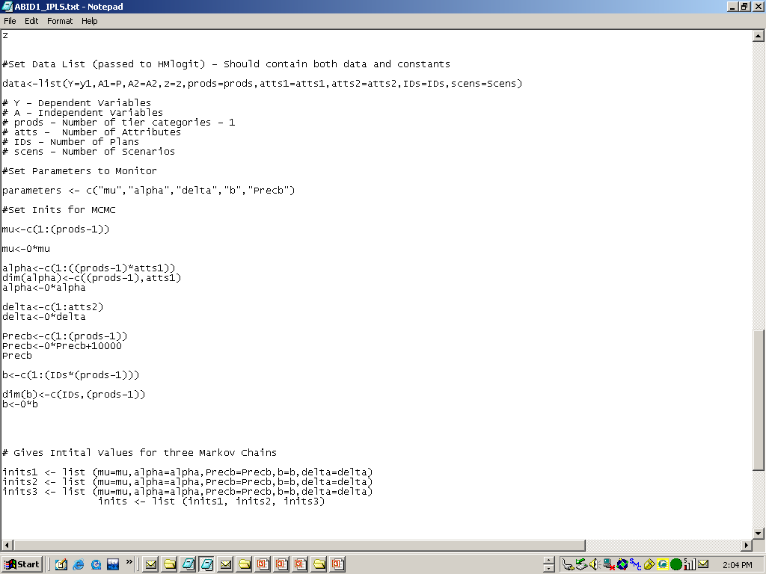
The model is setup for the analysis (no modifications required in this part of the code)
Physician Research – Modeling

Slide 49
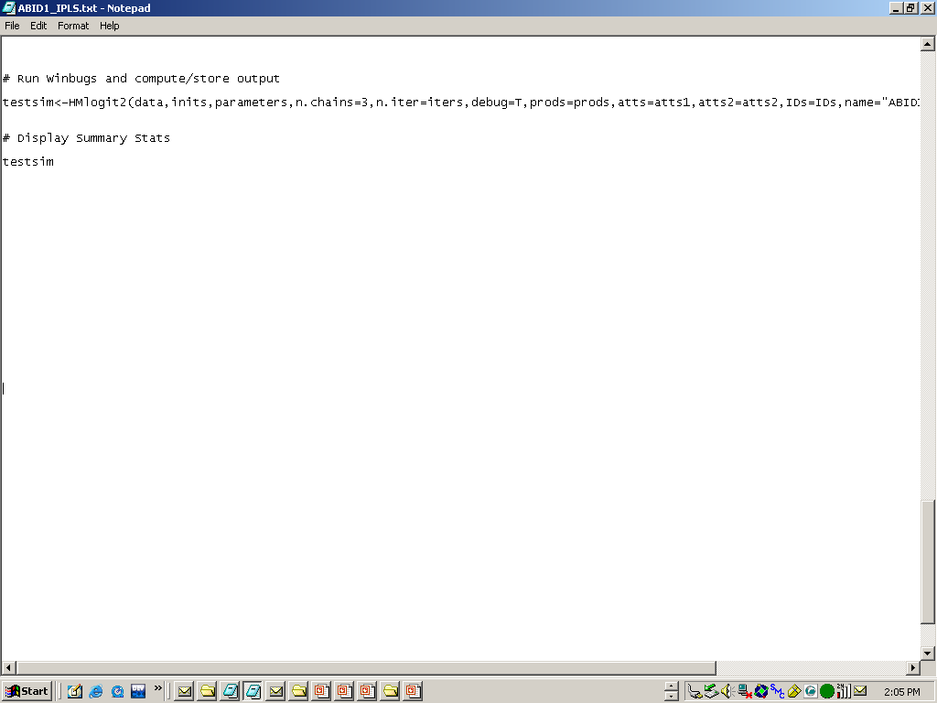
The model is then passed to WinBugs
Physician Research – Modeling
Note:The Hmlogit2 function writes several output files which are read into SAS for processing

Slide 50
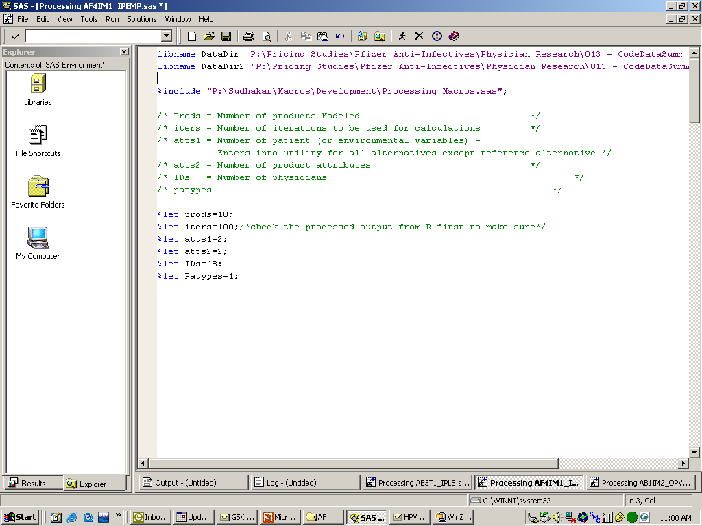
In SAS, the datadir is set, the processing macros included, and several Macro variables are set
Physician Research – Processing

Slide 51
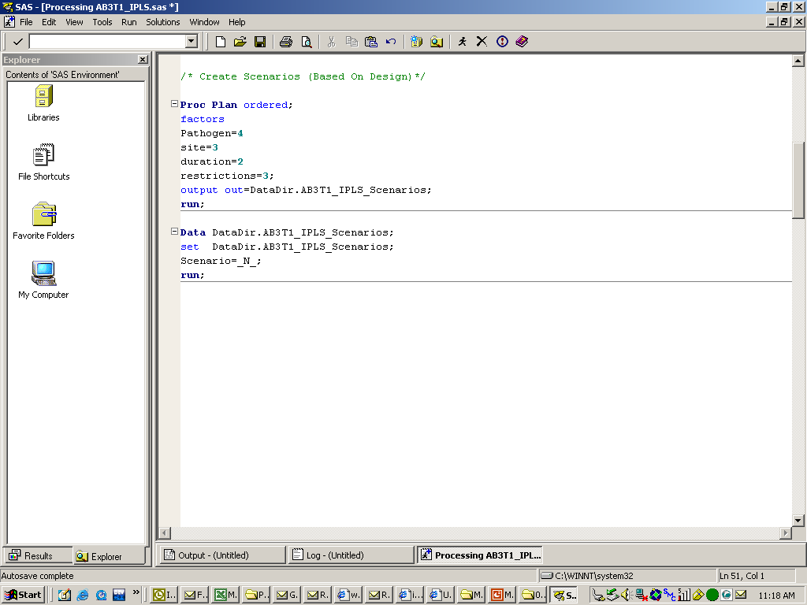
Create the “Scenarios” containing all combinations of the attributes and add the “Scenario” variable
Physician Research – Processing

Slide 52
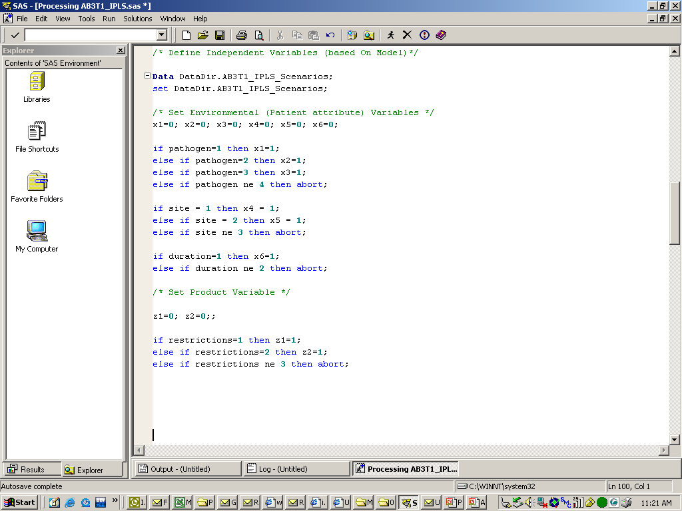
Remap design into patient and product variables used in the statistical models
Physician Research – Processing

Slide 53
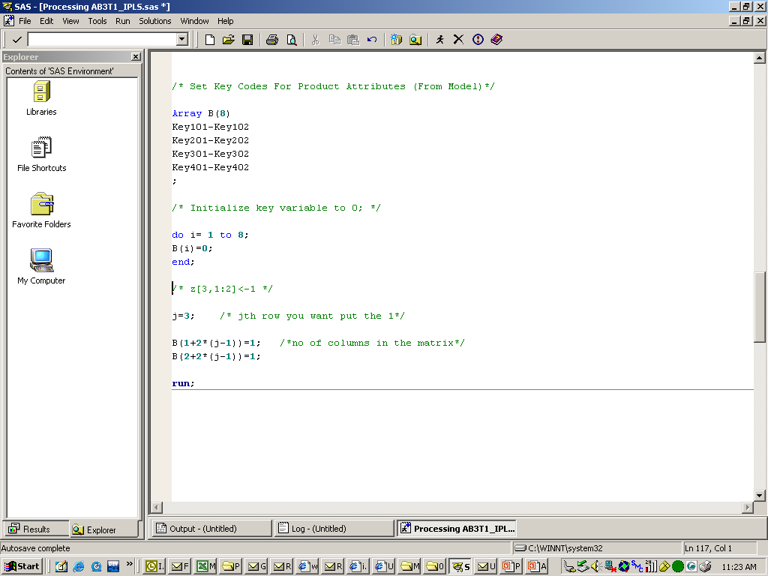
Set the key codes telling the program the product attributes that should be used for each product
Physician Research – Processing
Note:
Key101-Key102 are indicator variables (for inclusion in utility calculation) for product 1 (attributes 1-2)
Key201-Key202 are indicator variables (for inclusion in utility calculation) for product 1 (attributes 1-2)
Note:
The coding for the Key variables should correspond to that in the R code (good idea to copy the R-code as reference to ensure consistency)

Slide 54
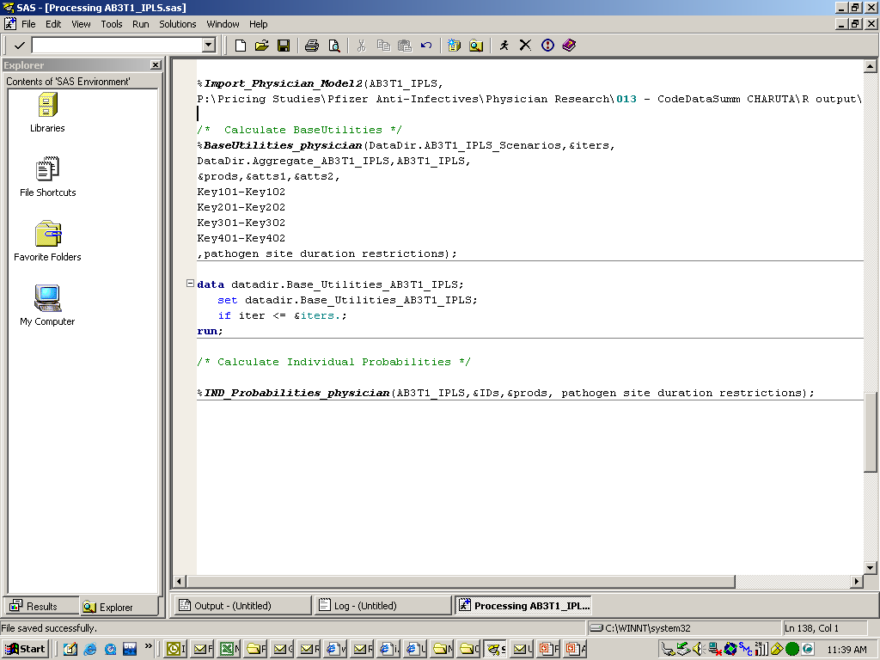
The Physician Model is imported, baseutilities calculated, and the individual physician level predictions calculated
(as averages across the included draws)
Physician Research – Processing
Note:
This part of the code could be time consuming and requires a Power PC
Number of records required at each step should be calculated to determine memory and storage needs
May want to edit to run one scenario at a time

Slide 55
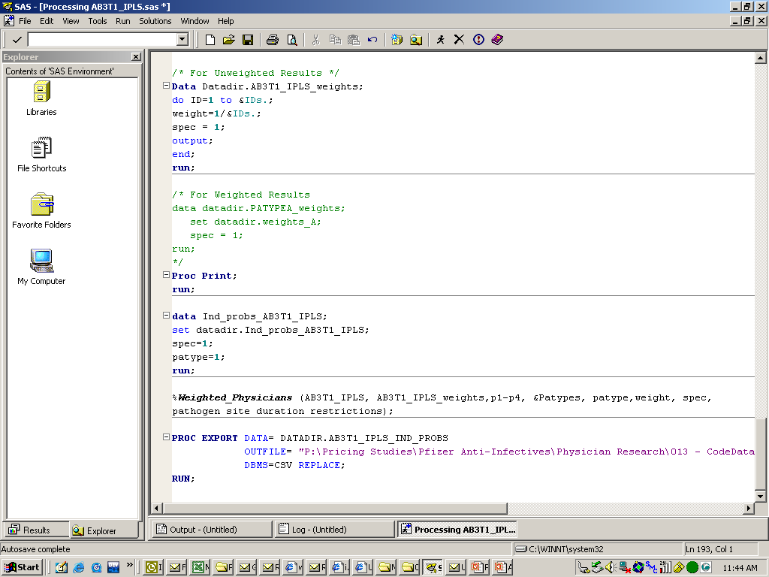
The results are weighted, processed by specialty and patient type, and stored in a final database for the simulator physician module
Physician Research – Processing

Slide 56
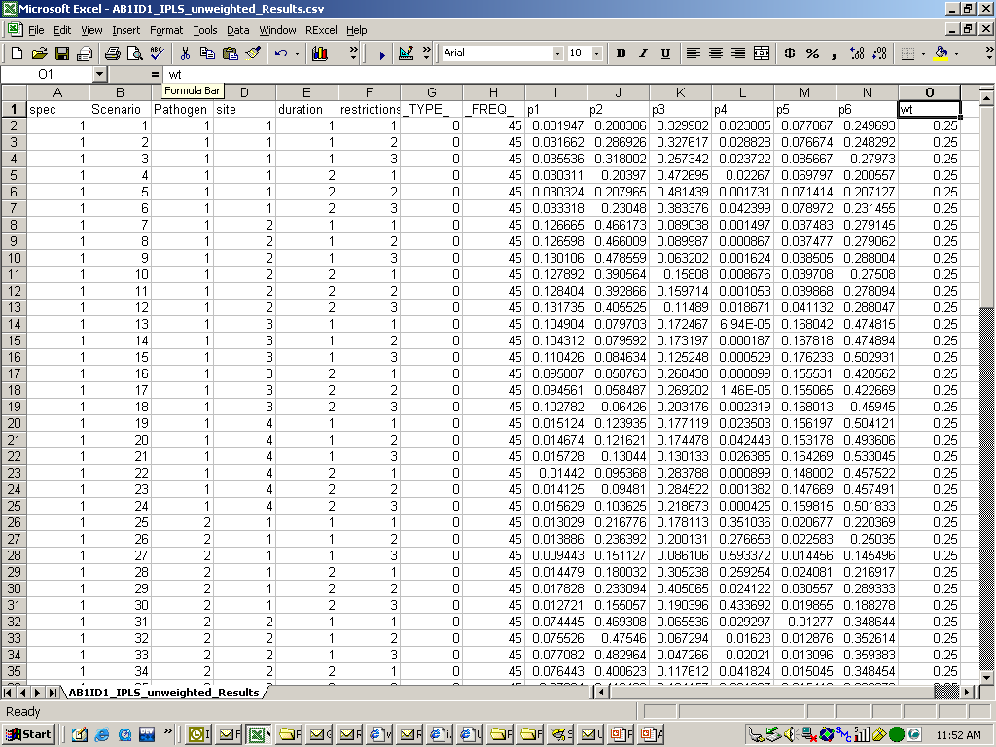
The final database is structured much like the payer database
Physician Research – Simulator Construction
Specialty/Patient type Variables
Model Variables
Model Predictions
Weighting Variable

Slide 57
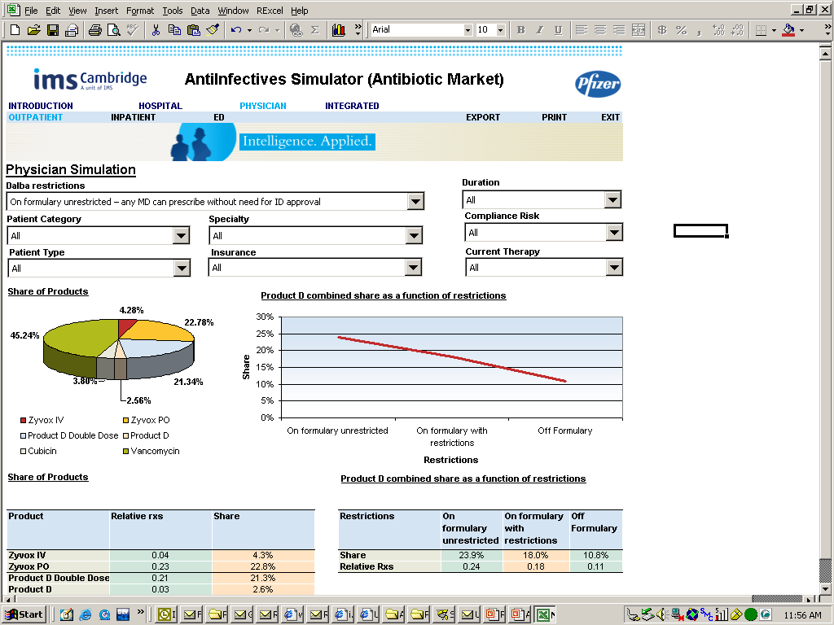
The output in the simulator includes both shares and relative RXs as a function of the various attributes
Physician Research – Simulator Construction

Slide 58
Agenda
General Overview
Payer Research
Physician Research
Integration

